Slide 1
Amazon & AWS Monitoring – Customer Case study

Slide 2
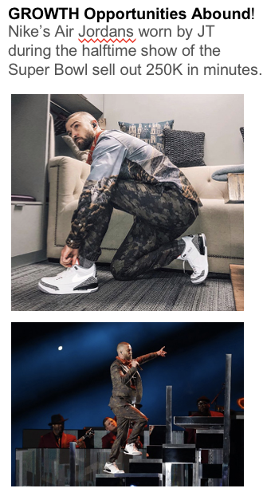
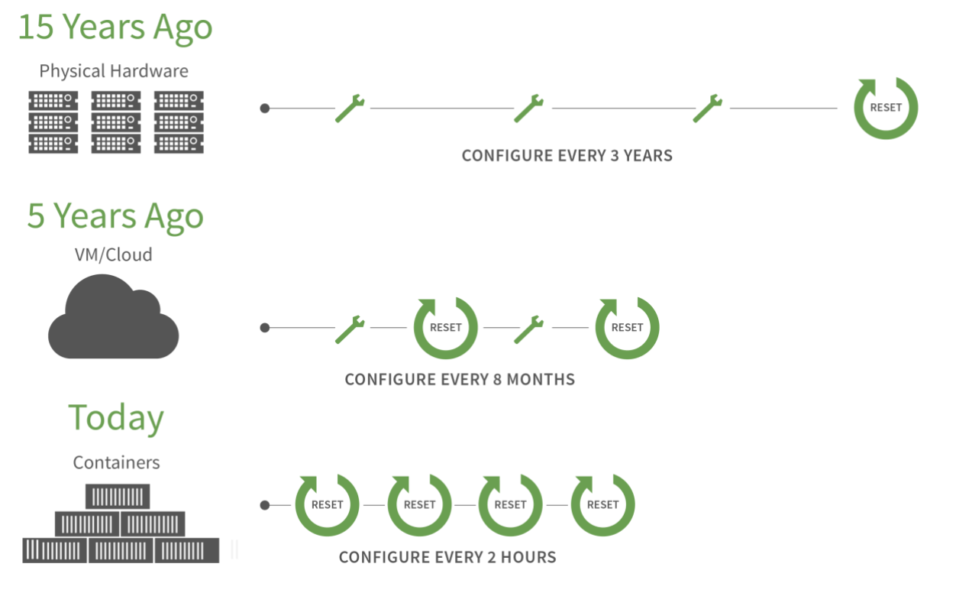
Monitoring an Open-Source, Ephemeral Environment?? .
Notes:
Amazon deploys micro-services every 11.6 seconds
Up to 30k hosts simultaneously receiving a deployment
1k+ max number of deployments in an hour
Operating in real time never more important than today. Whatever industry you are in, you have to invest in software. Nike: Business to consumer. No longer just retail. Customers buying directly from them. Shoe launch: 80% of business done in first two minutes. You need to have enough capacity in real time, and then when you are done, re-allocate that capacity. Similarly, NYT and Washington Post will tell you that 80% of their traffic during breaking news is in first two minutes of breaking event. Whatever industry, either real time requirements or variable load, are driving factors
The way these companies are investing in software manifests itself in different ways. One of our customers Nike is looking to leverage software to build a direct to consumer model. They are moving away from selling shoes via traditional retail stores and have built the Snkr app where the do these shoe launches and they actually do 80% of their revenue in the first 2 minutes of that launch.
So you can imagine they need to be able to scale up capacity very quickly to meet the demand, but then also scale it down very quickly once demand diminishes. We’re seeing these types play out not only in retail, but also across media and entertainment.

Slide 3
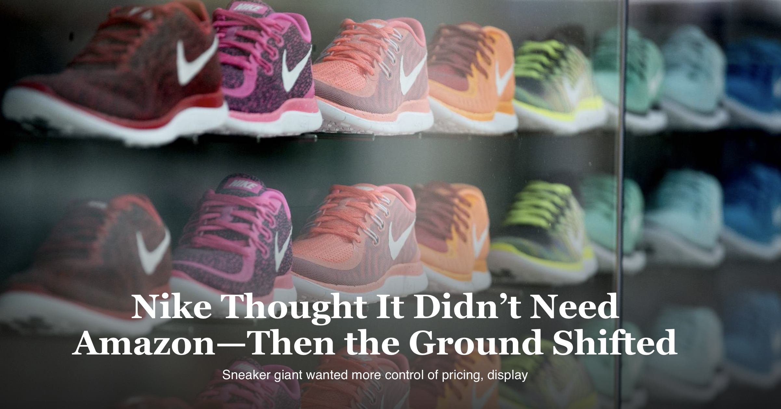

Slide 4



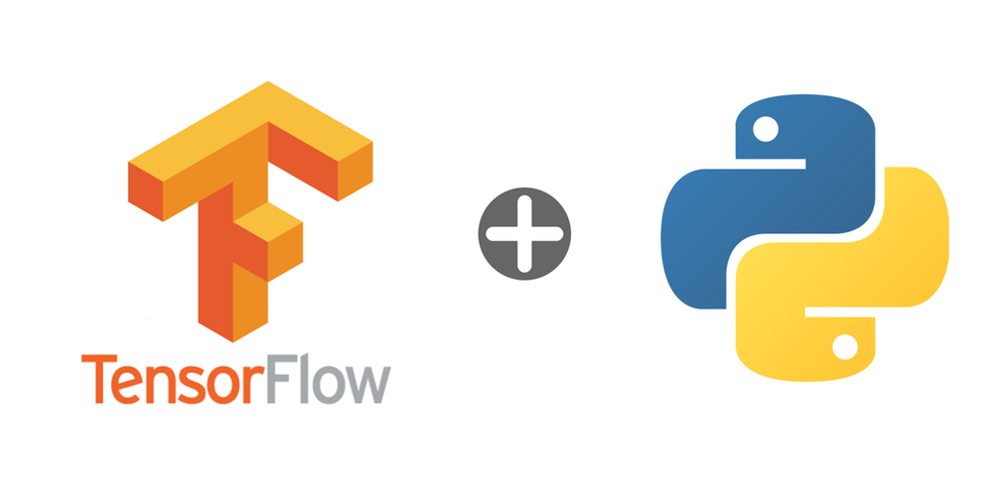

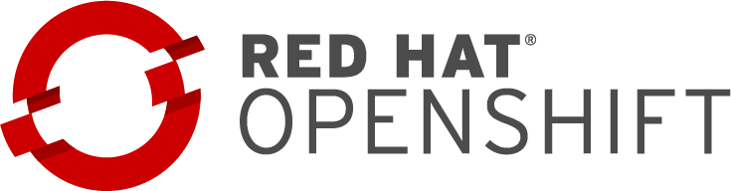







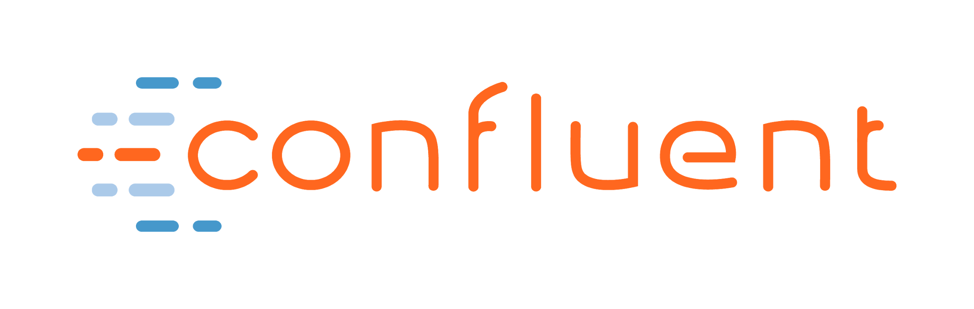
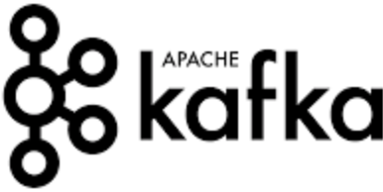




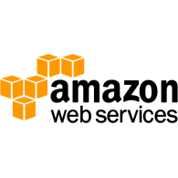
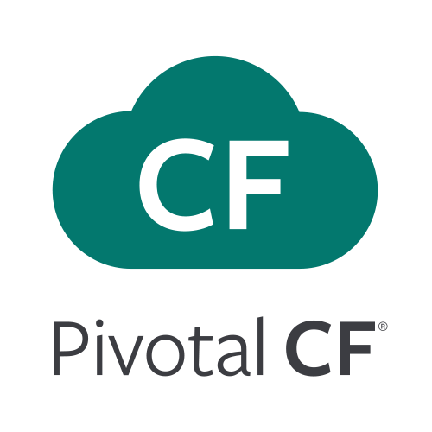

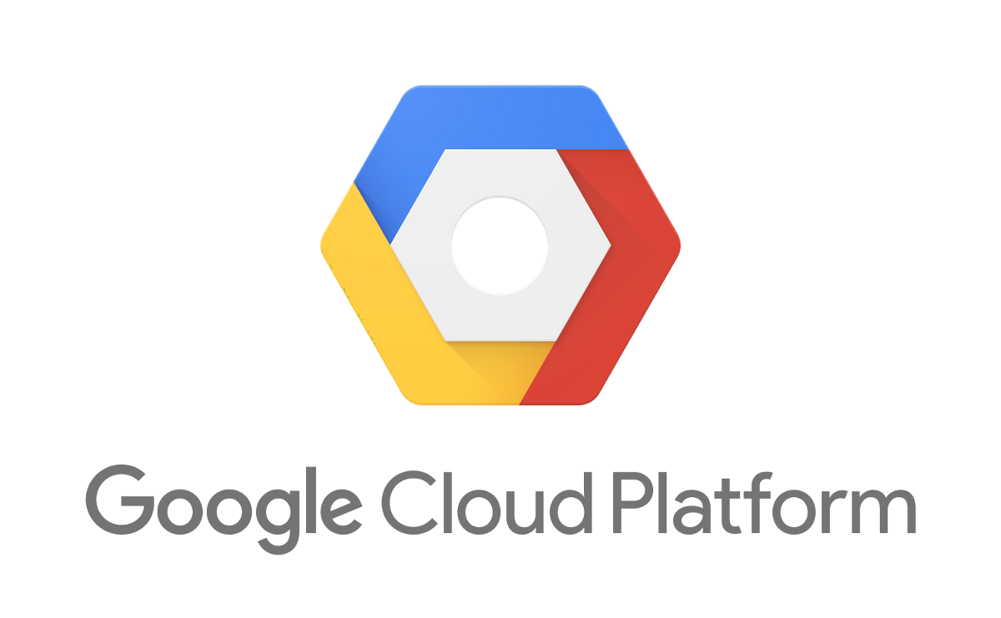

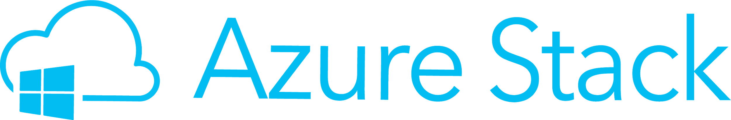
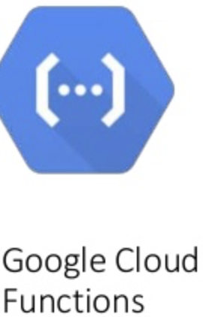
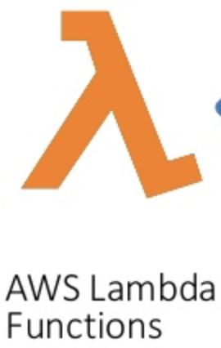
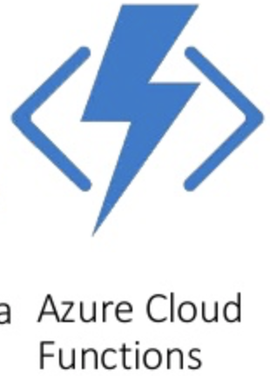
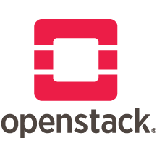
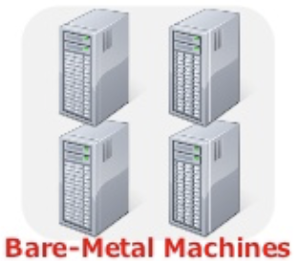
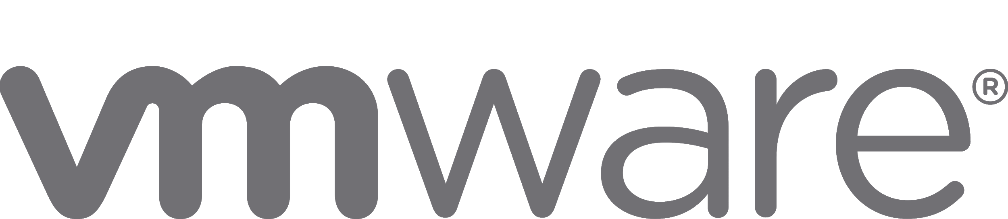
Nike was affected by 3 Major Trends that also hit most Innovative Enterprises
Data Services
Containers
Big Data Ingestion
ML / AI / IoT
Fast Data Analytics
Microservices
Orchestration
DevOps CI/CD
Cloud &
Hybrid Cloud

Slide 5
State of Business Prior to real-time monitoring
Nike is a world's leading designer, marketer, and distributor of authentic athletic footwear, apparel, equipment, and accessories for a wide variety of sports and fitness activities.
For years, Nike Inc. was one of the biggest holdouts against Amazon.com Inc
The explosion of third-party sellers on Amazon has led to authentic goods from companies such as Nike, Chanel, The North Face, Patagonia and Urban Decay being sold on Amazon even though they don’t authorize the sales, undercutting their grip on pricing and distribution.
Later on, Nike publicly stated that to maintain their leadership position as well as achieve 60% revenue growth by 2020, they were moving more Business to a direct to consumer sales model & w/ AWS.

Slide 6
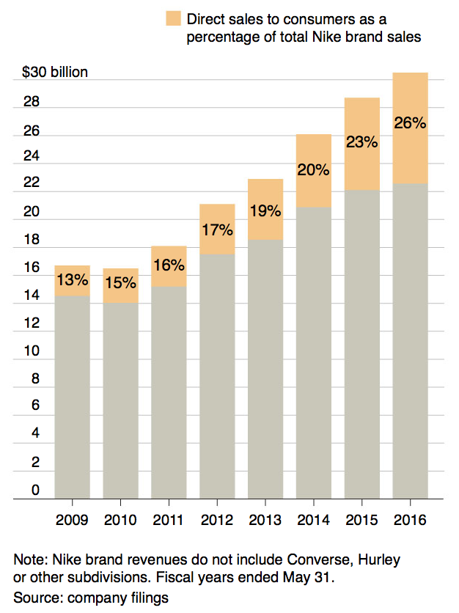
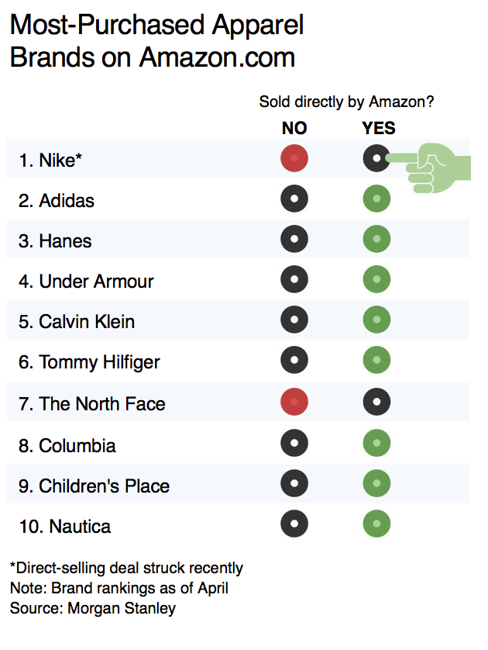
2017

Slide 7
Problem Statement/Definition:
As Amazon’s dominance in retailing has grown, traditional stores close, leaving even the most powerful brands unable to ignore it. Some companies, like Nike, disdained Amazon’s site design, which doesn’t conform to the tailored image they want to project.
To enable the direct to consumer model and avoid having to further invest in their own expensive on-premise infrastructure, Nike moved revenue generating apps under a newly appointed CDO and began migrating to Amazon Web Services.
The first on-premise component to be migrated was a monolithic ATG app that supported eCommerce. This app was broken into 30 Micro - Services & numerous Containers encompassing processes such as selecting shipping details, promotions, pricing, and checkout.

Slide 8
TECHNOLOGY IS MOVING US PAST THE TIPPING POINT
CONTAINERS
MICROSERVICES
MONITORING
CHALLENGES
>50%
>90%
>76%
>98%
of new workloads in Containers by 2019
of [enterprises] are using or plan to use microservices
of enterprises expect
to monitor microservices by the end of 2018
of those surveyed faced challenges with their microservices architecture
Gartner 2017 Strategic Roadmap for
Compute Infrastructure
Mike Cisek | George J. Weiss | Thomas J. Bittman | Andrew Butler | Arun Chandrasekaran | Chirag Dekate
SDX Survey of 353 senior development stakeholders, who are involved in microservices adoption in company with more than 500 employees
Dimensional Research
2018: WEDNESDAY / MAY 2
SDX CENTRAL REPORT
Gartner: How Microservices Have a Macroeffect on APM
Cameron Haight, Gartner
Notes:
Past the Tipping Point:
Function as a Service - Lambda in AWS, Functions as a Service in Azure,
The problems included an increase in operational burdens; inexperience and lack of skills from teams to build, leverage, and manage microservices; and increased difficulty in finding and resolving performance issues, which has impact on business.
Microservices architectures are more difficult to monitor because there is an increase in application data, and traditional monitoring tools are not designed for the complexity of microservices.

Slide 9
WHAT WE HEARD
Nike had a Customer First (C1) Innovation Lab to Drive Improved DTC Outcomes and Strengthen Customer Experience
Nike had lots of Development work on newer technologies like: Docker, Spark, Kafka, Elastic, Jenkins, Hadoop, etc….
Nike had large and growing adoption of AWS
Nike wanted a better way to Deliver, ‘Orchestrate’, Secure & ‘As a Service’ all these systems – quickly, cost efficiently and very repeatable.
"In today’s Real-Time Digital age, we are always considering ways to develop products and solutions to help drive improved revenue and better quality across the value chain," said Jim Scholefield, Chief Information Officer, Nike

Slide 10
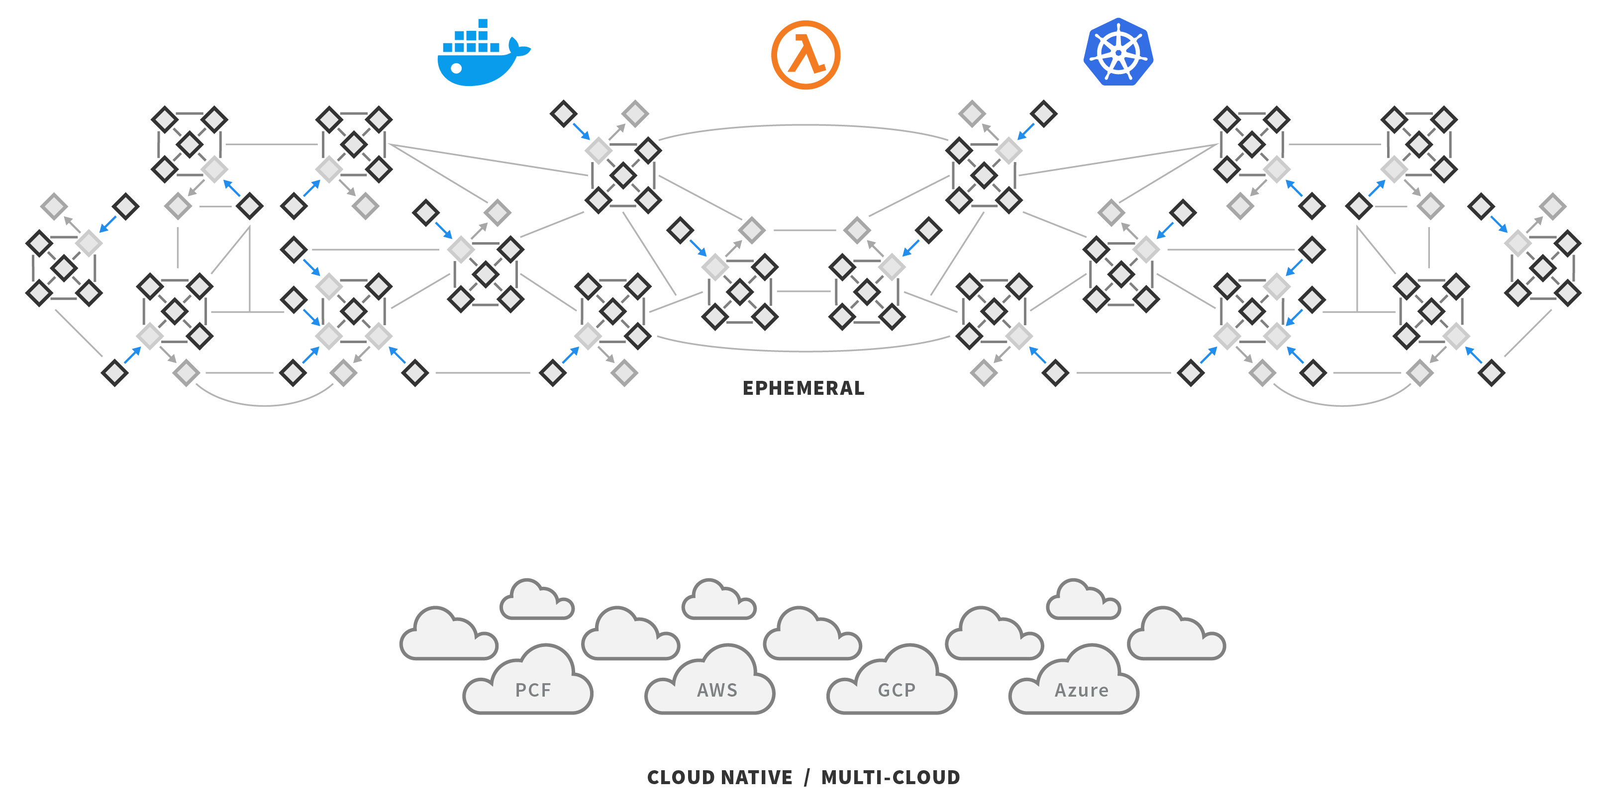












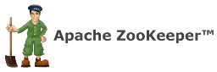
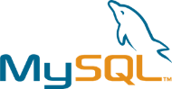



REAL-TIME APPLICATIONS REQUIRES THE ADOPTION OF NEW & COMPLEX TECHNOLOGY PLATFORMS
Microservices
& Functions
Containers
OSS
Hybrid Cloud
Environments
Notes:
Point is, these applications have varying workloads, real time requirements. That is driving new technology platforms. Not oracle, or SAP, or traditional enterprise apps. It is New apps, that are real time in nature, customer facing, and need to release quickly, and move quickly with markets that are driving containers, microservices, cloud adoption, open source, and new tech platforms. If you are not investing in these technologies, probably not focused on next gen apps needed to make business successful or into modern day architecture.
Its no longer the SAPs, the Oracles or old traditional apps but these new apps that are real-time in nature, customer facing, that have a need to delivery software quickly and move quickly with the market that are driving the adoption of the cloud/open source/containers/microservices.

Slide 11
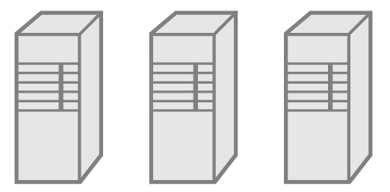
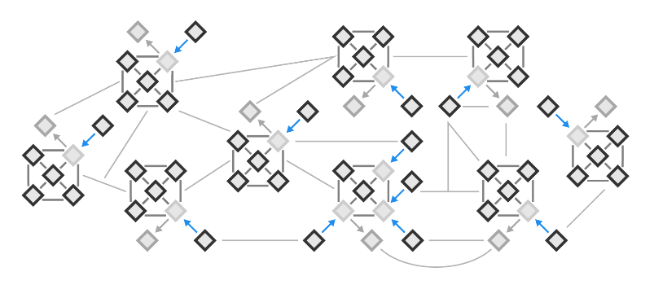
REAL-TIME REQUIRES HIGH-VELOCITY DELIVERY MODELS
BUILD
RELEASE
OPERATE
PLAN | CREATE | VERIFY
PACKAGE | CONFIGURE | DEPLOY
MONITOR | SUPPORT
DEV
OPS
OLD
Monolithic
Applications
NEW
Microservices
Containers
CI/CD
Serverless Functions
100x Components
10x Teams
100x Releases
1000x Dependencies
Notes:
THE WORLD IS CHANGING – AND XXX IS CHANGING WITH IT… as the technology platforms changed, how we build and deliver software has fundamentally shifted as well
-in the old world you would have a single development team working on one large release, then handing off to operations to roll this out across the production environment, but that is too slow for the new world
-everyone is moving to a CLOUD-NATIVE JOURNEY where there are lots of smaller teams working on smaller individual components of an entire application, independently pushing changes into production
It’s not just the technology that’s changing, its also the way we build and deliver software. No longer are there large monolithic applications built by big engineering teams who then punt it over to ops teams to release into production. Companies are moving towards this microservices based architectures where the infrastructure is no longer silo’d, everything is interconnected, you’re running hundreds or thousands of containers in production and you’re doing 100x more releases than you previously were.

Slide 12
Nike gets its footing — in the cloud:
Nike needed an elastic operating platform that could scale when needed it, and shrink when they didn’t. Based on this pre-requisite, the company began re-platforming its data centers to support its ongoing digital strategy — a move that is also better supporting critical product launches.
Nike began transitioning online operations to a cloud-based platform from Amazon Web Services.
“We need to be a technology-based company if we want to survive, especially since shoppers don't go to the mall like they used to,” Mike Wittig, VP infrastructure, Nike.
Besides enabling products to launch faster, AWS cloud platform automatically increases bandwidth during product launches to support volume growth, improves the order capture experience and streamlines order processing.

Slide 13
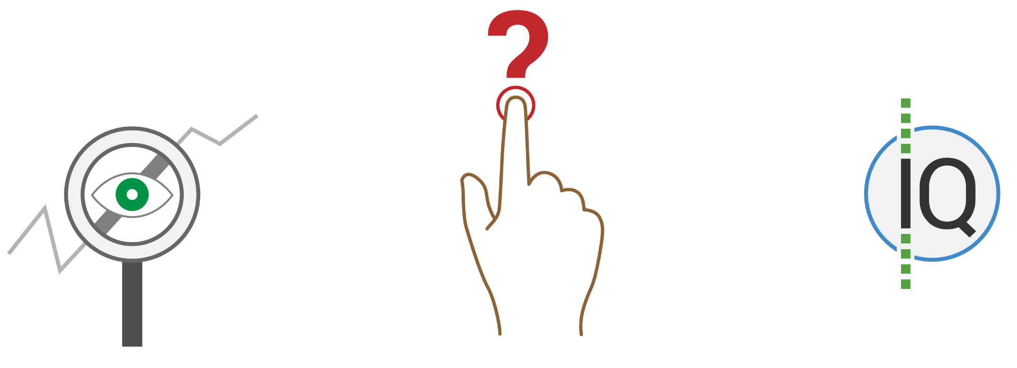
They couldn’t OPERATIONALIZE THESE launches WITHOUT REAL-TIME INSIGHT INTO APPLICATIONS
VISIBILITY / MONITORING
How long can you afford to wait
for ‘your’ alerts?
MORE PUSHES = MORE RISK
Can’t fly blind during frequent pushes
OPERATIONAL INTELLIGENCE
How are customers enjoying using the service?
99.99% Uptime = 4 mins Downtime / Month
Notes:
Simplified the Hierarchy of Monitoring Needs into three layers, each of which must be met before progressing to the next:
Reactive Monitoring. At any given time, which parts of your service are up or down?
Proactive Monitoring. Actively manage quality and performance. Identify and isolate issues before they impact users. Roll back changes or deploy fixes before a problem escalates.
Business Value. Correlate user and business metrics with infrastructure and application metrics to make decisions that drive new outcomes and desired results.
New APPS need a new way of monitoring. By shifting from a static view of your infrastructure to a metrics view, the entire organization can aggregate and interact with a breadth of streaming time series data across the entire stack. For the first time, you can alert on any metric that matters to your use case and compare to meaningful historical patterns and populations to evolve your signal as your services and infrastructure change.
Once you’ve applied meaningful metrics and alerts to your modern environment and overcome the most basic challenges related to the pace of change, you’ll already have the tools to advance towards the next levels of the monitoring hierarchy and the context for a more meaningful analytical approach to both your infrastructure and application operations and your business and customer objectives.

Slide 14
Proposed monitoring Solution:
The migration to AWS and OSS required a retooling of the legacy monitoring environment to include support for the latest cloud technologies, low latency reporting/alerting, the ability to pickup ephemeral components, and support for tremendous bursts in compute.
Nike got a real-time streaming operational intelligence platform that was able to utilize four data collection technologies pushing metrics to their analytics/alerting engine.
The first component was their native integration to CloudWatch that pulls existing metrics and any available tags/environment details from all AWS services.
The second component is their version of the open-source CollectD agent that provides detailed system metrics from EC2 hosts.
The third component is the Real-Time Lambda Wrapper that allows for broad Lambda monitoring.
The final component is the Real-Time code library that allows custom instrumentation to send metrics directly from Nike’s bespoke code.

Slide 15
The monitoring Outcome:
With Real-time Monitoring deployed, Nike is able to correlate events & metrics across AWS services in real-time and ensure their new elastic environment has 100% monitoring coverage.
These metrics are correlated in real-time and with one second granularity. The metrics are highly cardinal ensuring that the alerts and visualizations being created within seconds are germane to actual or inevitable outages.
This has allowed a rapid deployment into AWS and confidence to continue the migration. In addition to coverage, they are seeing lower staffing costs as well as reduced MTTR.
Staffing costs are lower because of the correlation Monitoring provides across services. Traditionally, Nike had SREs onsite to cover every eventuality. With Real-time Monitoring, generalist SREs are able to quickly determine where a problem has occurred or is about to occur and can delegate without needing all hands on deck. This capability also lowers MTTR because time is not lost tracking down hunches.

Slide 16
results:
AWS Services Used = Lambda, EC2, SQS, ElastiCache
“A healthy launch is about 300,000 requests per minute, and this could climb to 1 million requests,” Mike Wittig, VP infrastructure, Nike.
During one sale, Nike was able to catch an error condition instantly that their legacy APM tooling did not report for 37 minutes. “We wouldn’t be able to do this without you.” - Mike to Professional Services Team
Number of Distinct Applications Migrated - One monolithic app broken into five components consisting of 30 micro services & numerous Containers.

Slide 17

DEMONSTRATION &
STREAMING ARCHITECTURE

Slide 18
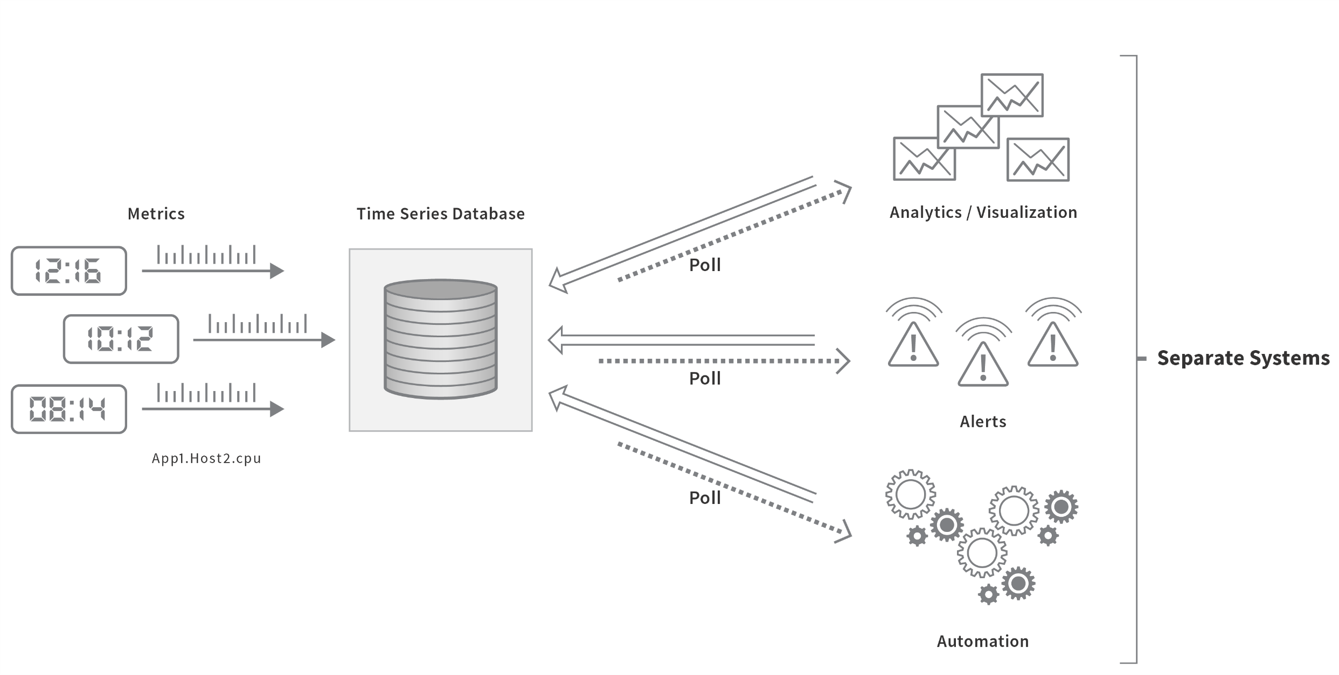
TRADITIONAL METRICS ARCHITECTURE
A patchwork of separate systems leads to poor usability and difficulty of operation
Service: Competitor, WaveFront
Storage: Prometheus, Influx, OpenTSDB, WaveFront
Charts: Grafana/Graphite, home-grown
Alerts: Sensu, Prometheus, home-grown
Data Science: R, home-grown

